Slide 1


Slide 2

Industry Spicer
Minor-Project
Gear Contact Pattern Inspection
Team 17
SL.No. | Name | USN
1. | Rakshita Belakoppa | 01FE22BCI058
2. | Drakshayani R C | 01FE22BCI028
3. | Nikhita Mane | 01FE22BCS284
4. | Pooja Karagi | 01FE22BCS214
Guide: Mrs. Nagaratna Yaligar
School of Computer Science and Engineering

Slide 3

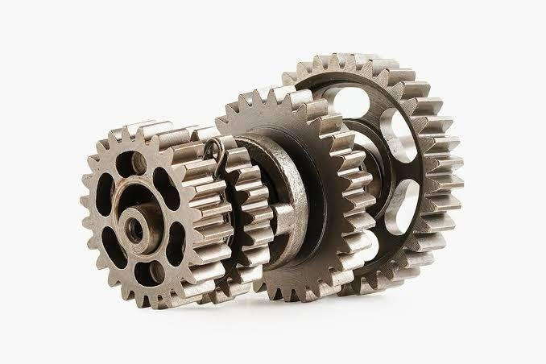
Problem Statement:
Manual inspection of gear contact patterns is time-consuming and error-prone. Existing automated solutions are limited, costly, or not tailored for contact pattern classification. This leads to inconsistent quality control and reduced efficiency. We propose a scalable ML-based system to automate gear pattern inspection.
School of Computer Science and Engineering
3

Slide 4
Introduction
This project focuses on developing an automated classification system for gear contact patterns using deep learning. It aims to classify patterns as "OK" or "NOT OK", replacing traditional manual inspections. Manual methods are prone to subjectivity, human error, and inefficiency. By automating this process, the system ensures faster, more accurate, and consistent evaluations. It enhances quality control in differential gear assemblies and supports real-time decision-making. The approach also reduces dependency on skilled human inspectors, improving scalability.
School of Computer Science and Engineering
3

Slide 5
Requirements
Collect a dataset of gear contact pattern images clearly labeled as "OK" (acceptable) or "NOT OK" (defective), ensuring enough samples in both classes for effective training.
Ensure images cover various gear types, lighting conditions, and viewing angles to capture real-world variability.
Define an image capture protocol that maintains consistent image quality and resolution for reliable pattern visibility.
Plan for data preprocessing and augmentation strategies to enhance dataset diversity and address class imbalances before model training.
School of Computer Science and Engineering
3

Slide 6
Dataset Description
The dataset should contain images of gear contact patterns.
It must have an equal number of "OK" (acceptable) and "NOT OK" (non-acceptable) images to ensure balanced training and evaluation.
Each image should be labeled correctly as either "OK" or "NOT OK".
Images should cover different types of parts and varying conditions (e.g., lighting, angle) to make the model more robust.
The quality of images must be good enough to clearly show the gear contact patterns.
A sufficient number of samples should be collected daily to maintain consistency and support model updates if needed.
School of Computer Science and Engineering
3

Slide 7
Objectives:
To develop a platform capable of automatically detecting acceptable and non-acceptable gear contact patterns.
To summarize and store daily inspection data along with corresponding images and results.
To ensure consistent quality by comparing gear patterns part-wise on a daily basis.
To support decision-making by providing systematic and reliable gear inspection reports.
School of Computer Science and Engineering
3

Slide 8
Implemented
Model Training Approach:
We implemented MobileNetV2/MobileNetV3 for binary classification of gear contact patterns as "OK" and "NOT OK".
Data Augmentation:
The original dataset had more "OK" images than "NOT OK". To handle class imbalance, we performed data augmentation only on the "NOT OK" images. Such as Rotation, Flipping, Scaling, Brightness/Contrast adjustments. This helped generate additional "NOT OK" images and balance the dataset for fair training.
School of Computer Science and Engineering
3

Slide 9
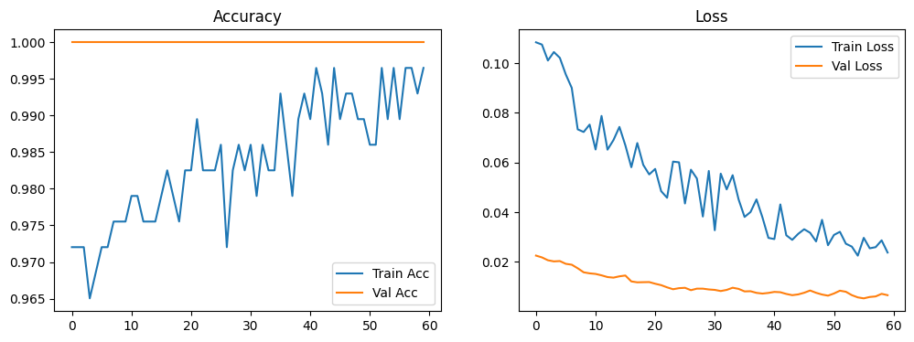
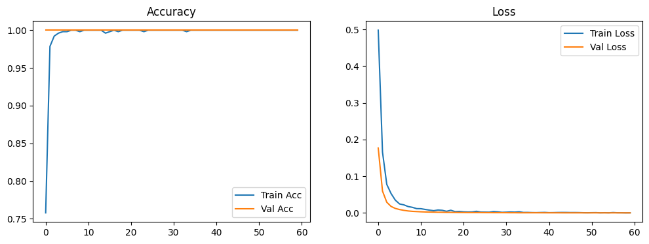
Accuracy of MobileNetV2 Model
without Augmentation : 99.79% with Augmentation : 100%
School of Computer Science and Engineering
3

Slide 10
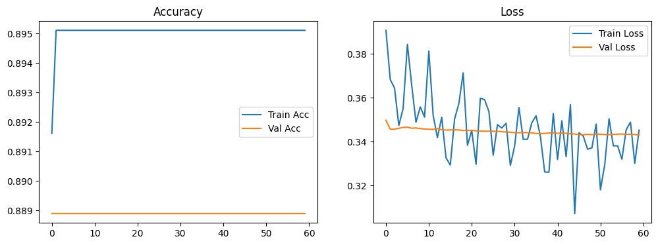
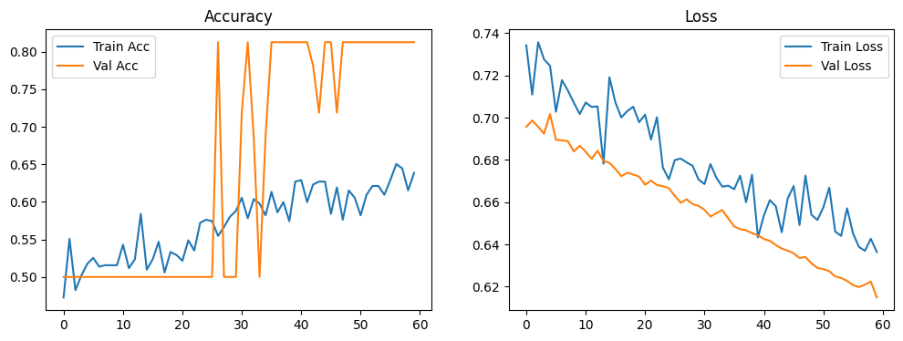
Accuracy of MobileNetV3 Model
without Augmentation : 89.71%​
with Augmentation : 65.68%​
School of Computer Science and Engineering
3

Slide 11
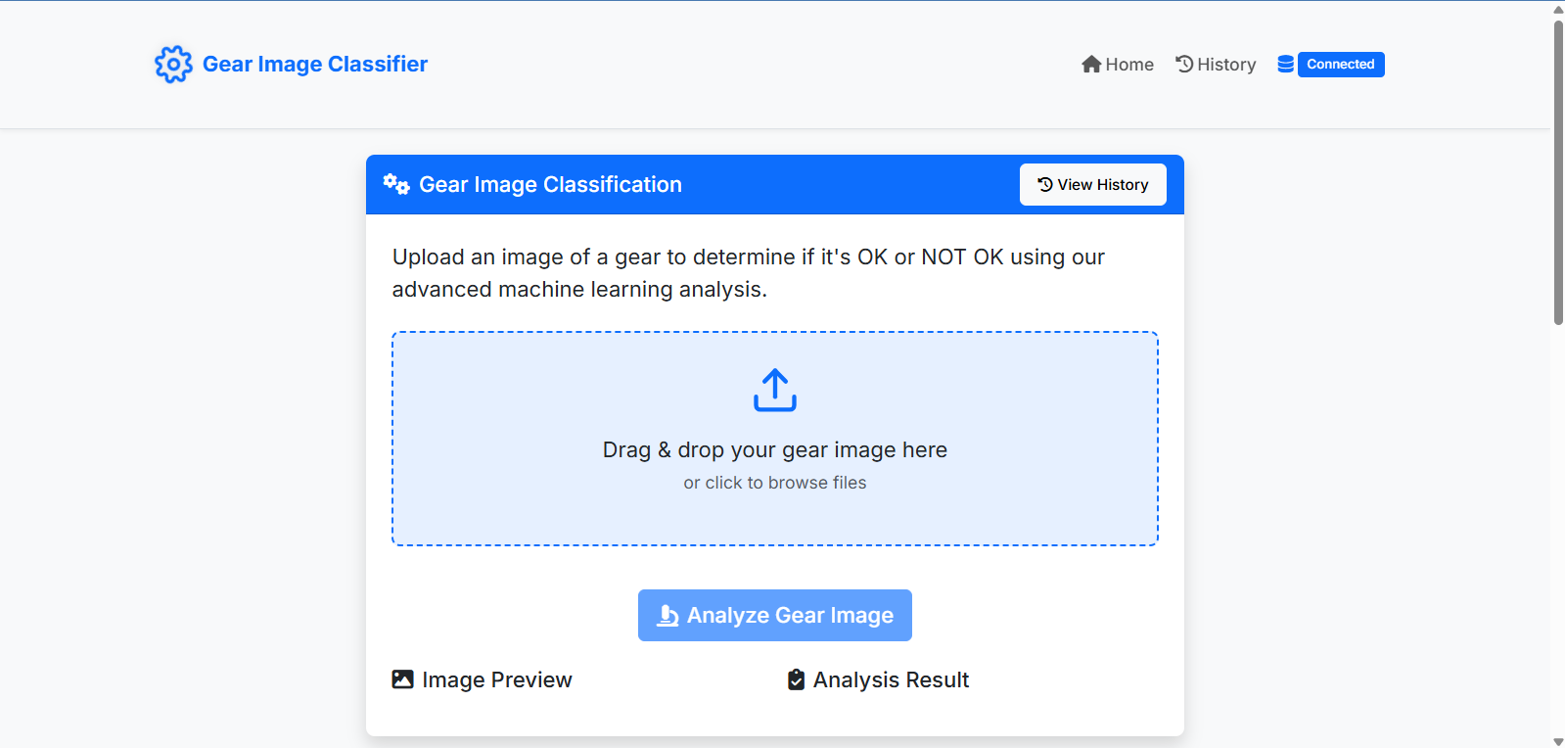
Website of gear contact pattern checker
School of Computer Science and Engineering
3

Slide 12
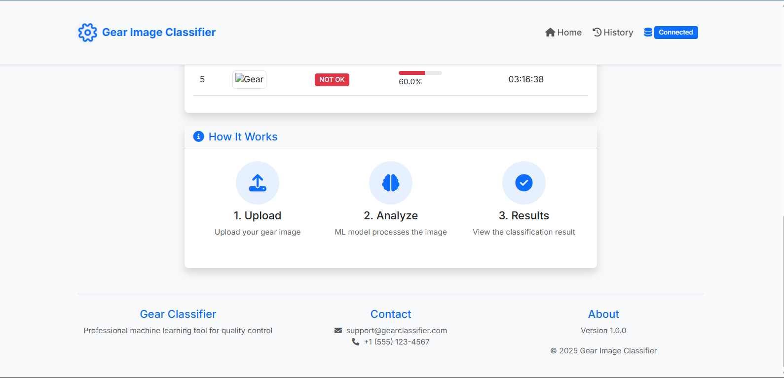
Website of gear contact pattern checker
School of Computer Science and Engineering
3

Slide 13
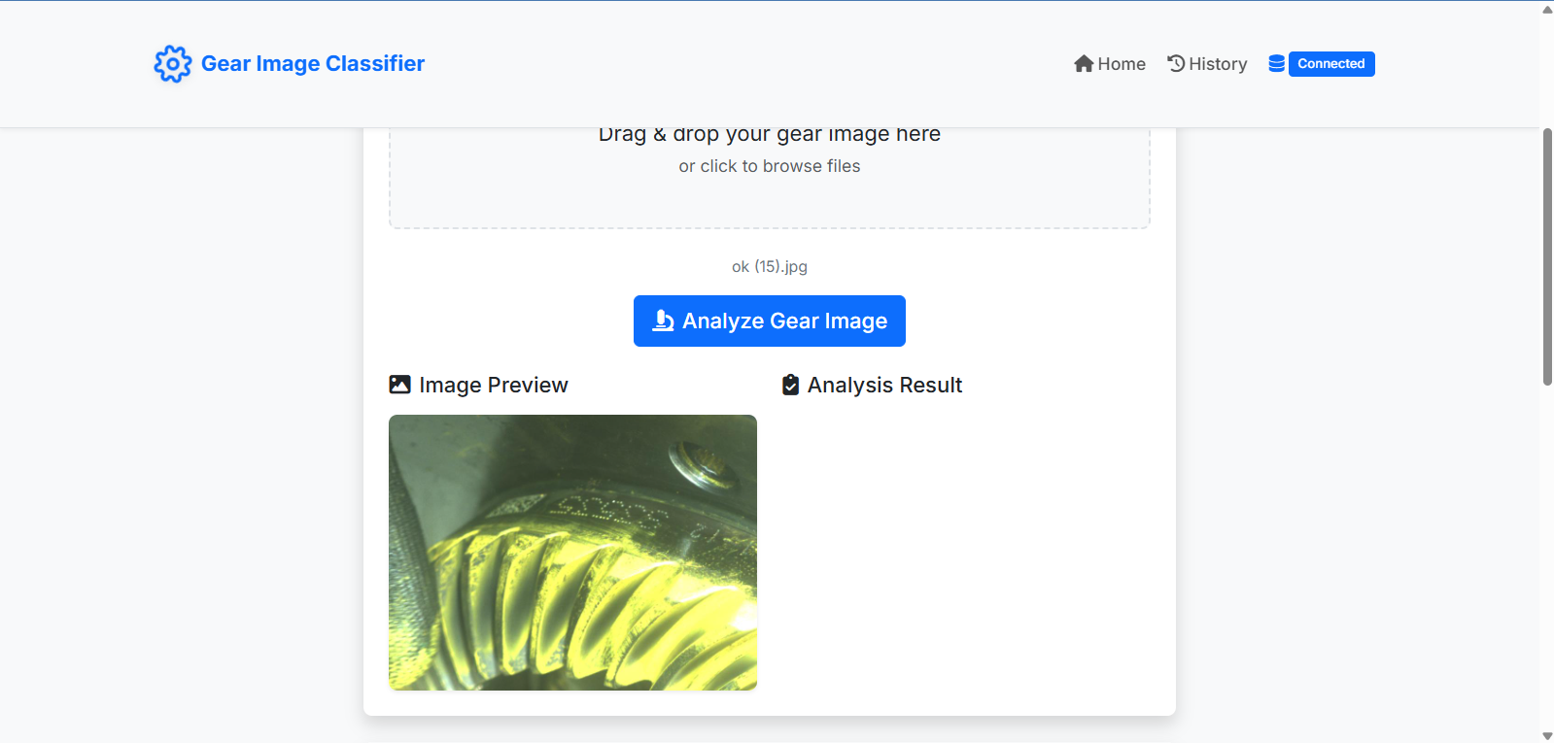
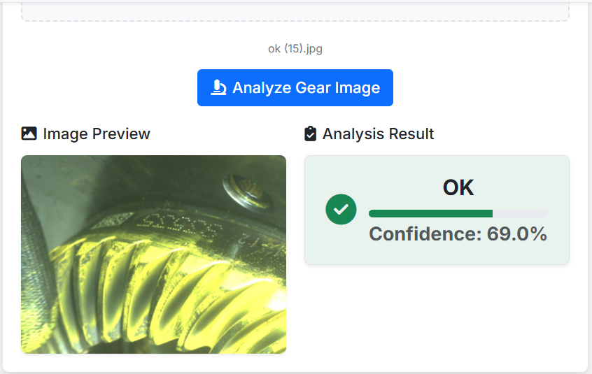
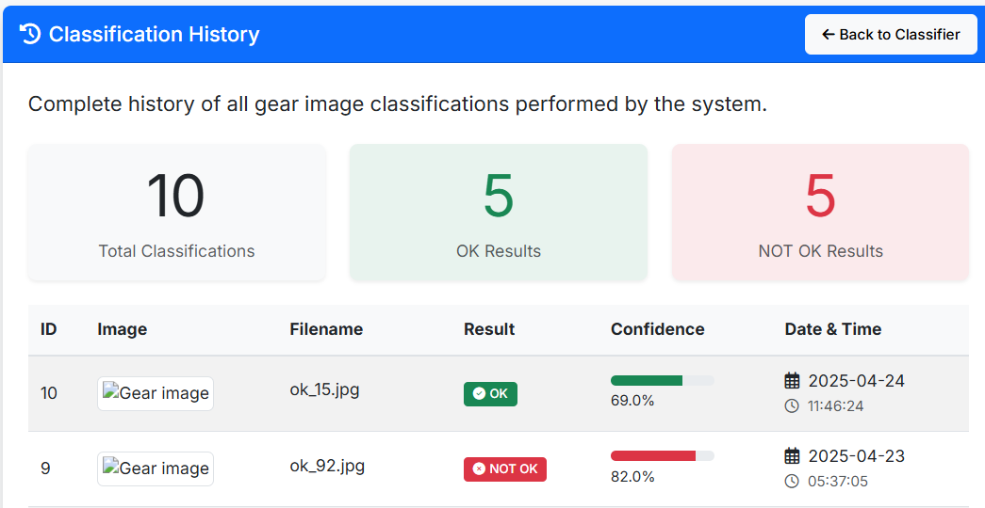
Working of Website
School of Computer Science and Engineering
3

Slide 14
Challenges Faced
Class Imbalance in Dataset
The current dataset provided includes:
400 OK images and
Only 47 NOT_OK images.
This results in a severe class imbalance, causing the model to learn predominantly from OK examples, which leads to poor generalization on NOT_OK cases.
Impact on Model Performance:
Despite achieving high accuracy on training/validation (as seen in MobileNetV2), the model tends to predict 'Not OK' for most inputs, even when it's Ok.
MobileNetV2 showed better convergence, but OK detection is still weak due to data imbalance.
School of Computer Science and Engineering
3

Slide 15
Solution ?
Need More NOT_OK Samples:
To develop a reliable and production-ready classification system that can detect defects patterns effectively, a balanced dataset is crucial.
What We Need:
At least 300-350 additional NOT_OK images to ensure Class balance.
Ideally, maintain at least 1:3 ratio of NOT_OK to OK for improved performance.
Why This Matters:
A better-balanced dataset will allow:
Improved recall on NOT_OK images (fewer false negatives).
More trustworthy model predictions in a real-world setting.
Better feature learning from actual gear defects.
School of Computer Science and Engineering
3

Slide 16
Conclusion
The creation of an automated gear contact patten classifier is substantial move towards advancing quality control in differential gear production. By preventing human error and making inspections routine, the platform guarantees consistent and dependable evaluations. Not only does it enhance efficiency in operations, but it also maximizes product quality and longevity. The platform facilitates real-time monitoring and knowledge-based decision-making through clear reporting. Ultimately, it lends itself to lower rates of failure and greater reliability in gear assemblies.
School of Computer Science and Engineering
3

